Slide 1
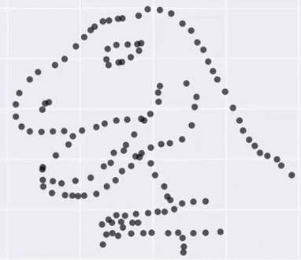
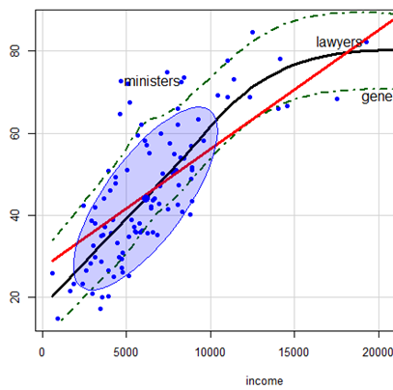
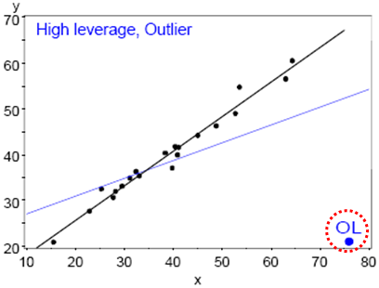
Visualizing Linear Models: An R Bag of Tricks Session 1: Getting Started
Michael Friendly
SCS Short Course
Oct-Nov, 2022
https://friendly.github.io/VisMLM-course/

Slide 2
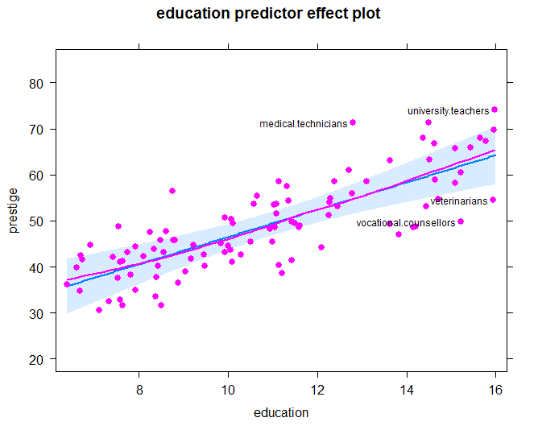
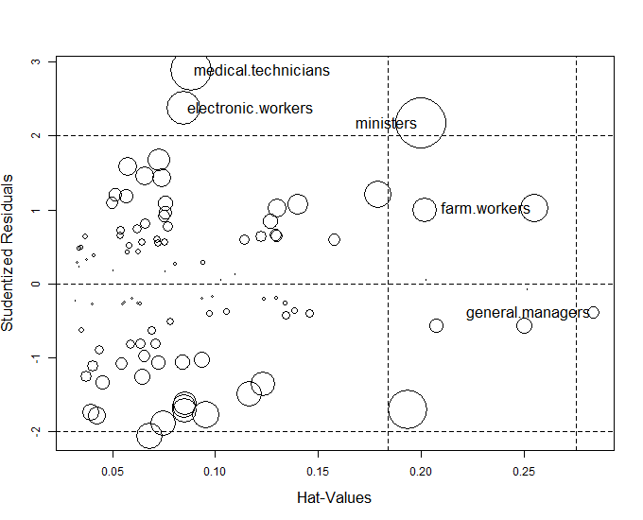
Today’s topics
What you need for this course
Why plot your data?
Linear models review
Data plots: really see your data
Model (effect) plots: see net effects of predictors
Diagnostic plots: what’s wrong with my model?

Slide 3



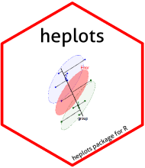

What you need
R, version >=3.6 [R 4.1 is current]
Download from https://cran.r-project.org/
RStudio IDE, highly recommended
https://www.rstudio.com/products/rstudio/
R packages: see course web page
car
effects
heplots
candisc
visreg
R script to install packages: https://friendly.github.io/VisMLM-course/R/install-vismlm-pkgs.R

Slide 4


Why plot your data?
Getting information from a table is like extracting sunlight from a cucumber. --- Farquhar & Farquhar, 1891
Information that is imperfectly acquired, is generally as imperfectly retained; and a man who has carefully investigated a printed table, finds, when done, that he has only a very faint and partial idea of what he has read; and that like a figure imprinted on sand, is soon totally erased and defaced.
--- William Playfair, The Commercial and Political Atlas (p. 3), 1786

Slide 5
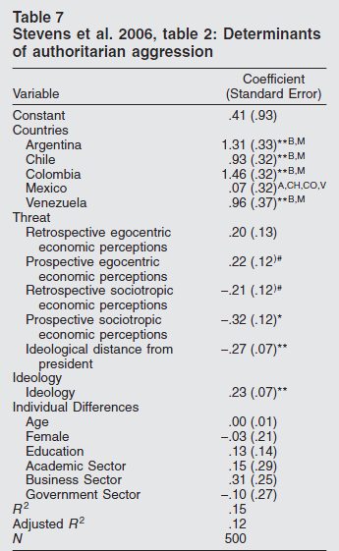
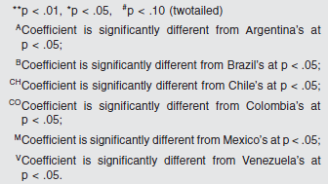
Cucumbers
Results of a one model for authoritarian aggression
The information is overwhelmed by footnotes & significance **stars**

Slide 6

What’s wrong with this picture?

Slide 7
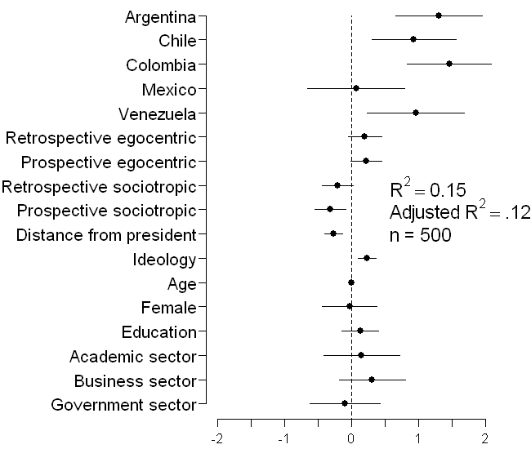
Sunlight
coefplot(model)
Why didn’t they say this in the first place?
NB: This is a presentation graph equivalent of the table
Shows standardized coefficient with 95% CI
Factors (Country, sector) are shown relative to the baseline category

Slide 8

Run, don’t walk toward the sunlight

Slide 9

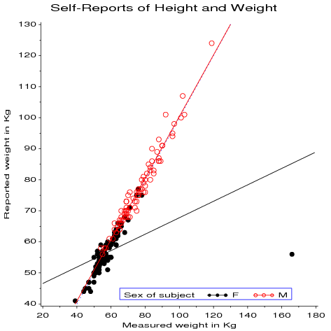
Graphs can give enlightenment
The greatest value of a picture is when it forces us to notice what we never expected to see.
-- John W. Tukey
Effect of one rotten point on regression

Slide 10
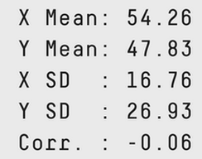
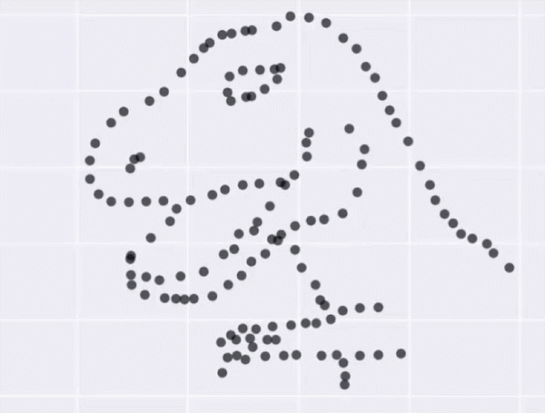
Dangers of numbers-only output
Student: You said to run descriptives and compute the correlation. What next?
Consultant: Did you plot your data?
With exactly the same stats, the data could be any of these plots
See how this in done in R: https://cran.r-project.org/web/packages/datasauRus/

Slide 11
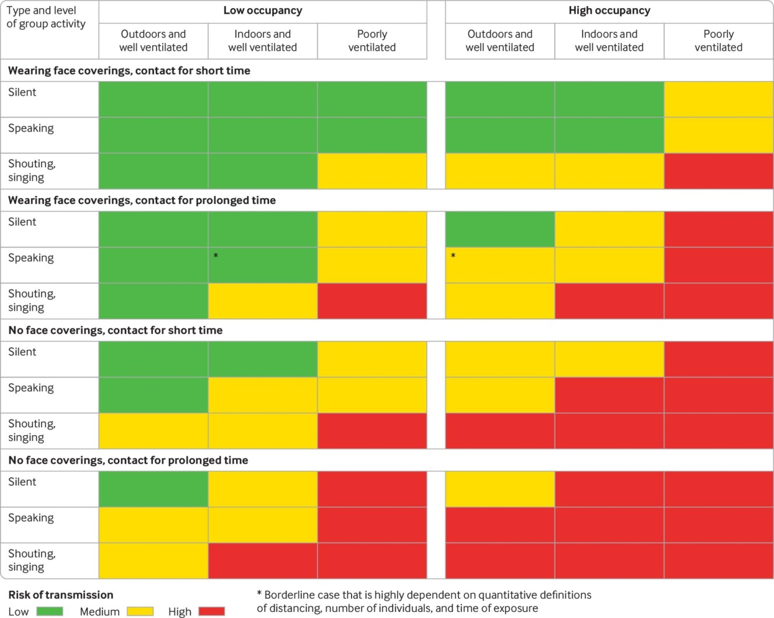
Sometimes, don’t need numbers at all
COVID transmission risk ~ Occupancy * Ventilation * Activity * Mask? * Contact.time
A complex 5-way table, whose message is clearly shown w/o numbers
A semi-graphic table shows the patterns in the data
There are 1+ unusual cells here. Can you see them?
From: N.R. Jones et-al (2020). Two metres or one: what is the evidence for physical distancing in covid-19? BMJ 2020;370:m3223, doi: https://doi.org/10.1136/bmj.m3223

Slide 12
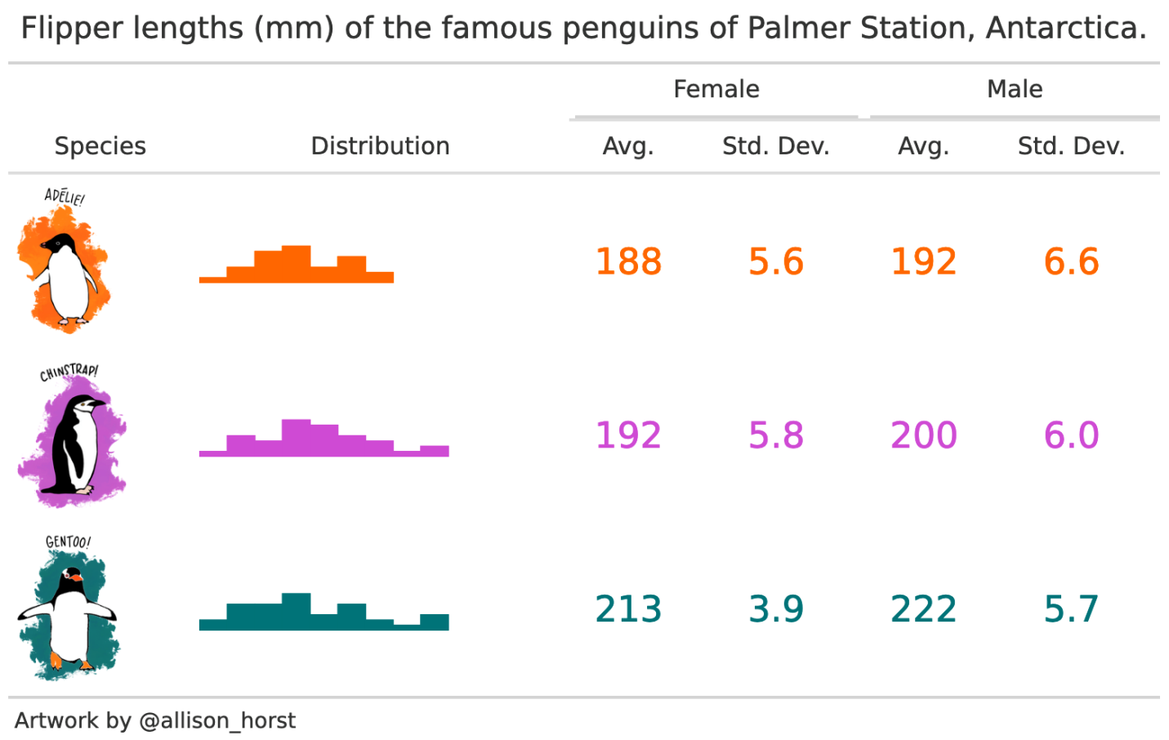
If you do need tables– make them pretty
Several R packages make it easier to construct informative & pretty semi-graphic tables
Presentation graph
Perhaps too cute!
Distribution of variables shown
produced using modelsummary::datasummary, https://vincentarelbundock.github.io/modelsummary/articles/datasummary.html

Slide 13
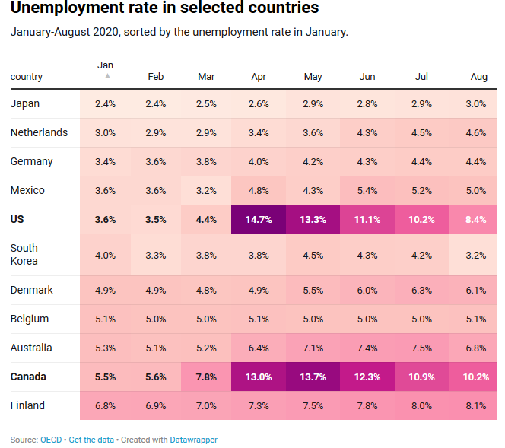
Visual table ideas: Heatmap shading
Heatmap shading: Shade the background of each cell according to some criterion
The trends in the US and Canada are made obvious
NB: Table rows are sorted by Jan. value, lending coherence
Background shading ~ value:
US & Canada are made to stand out.
Tech note: use white text on a darker background

Slide 14
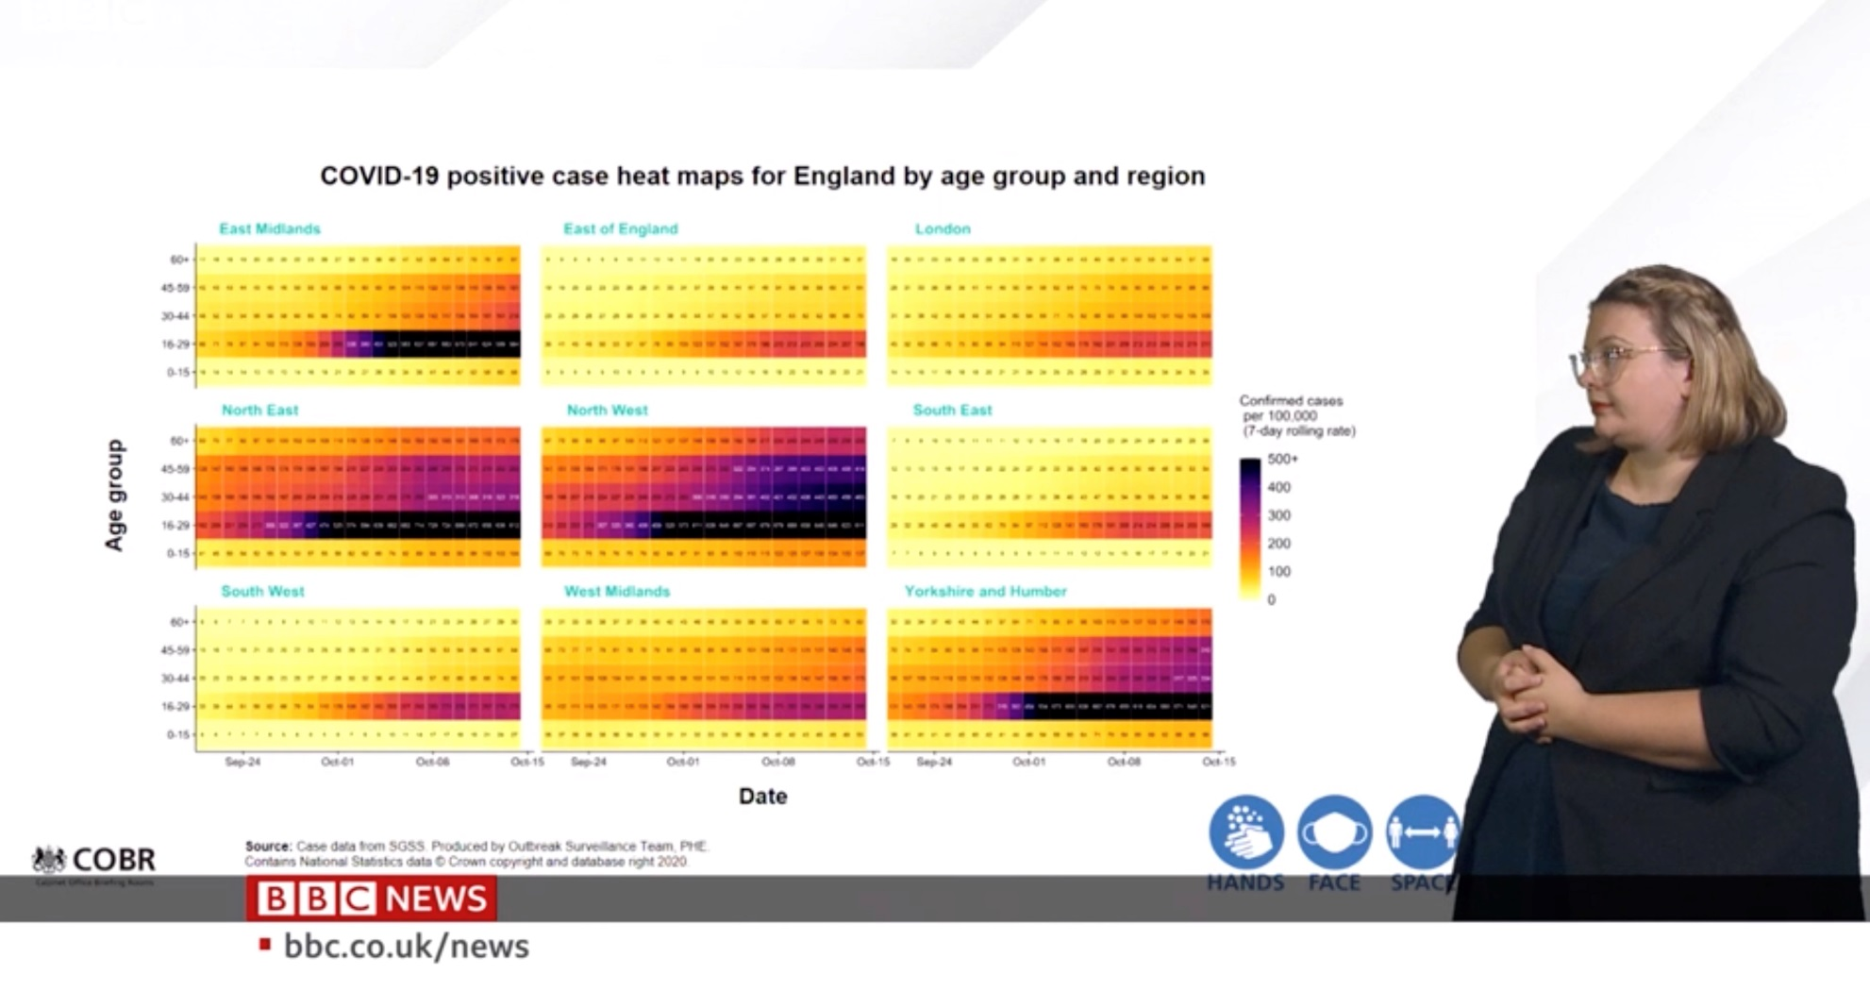
Visual table ideas: Heatmap shading
As seen on TV …
Covid rate ~ Age x Date x UK region
Better: incorporate geography, not just arrange regions alphabetically

Slide 15
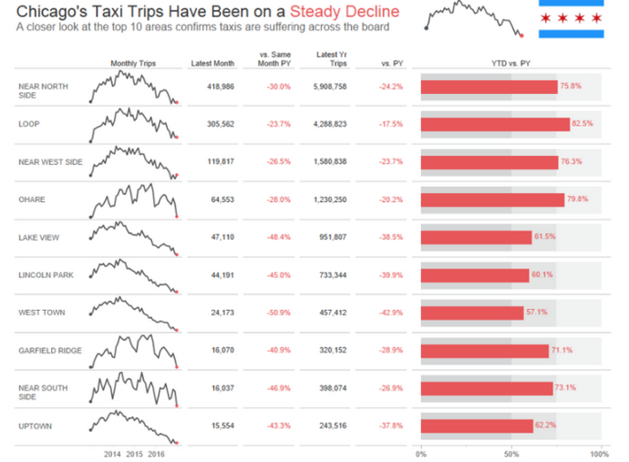
Visual table ideas: Sparklines
Sparklines: Mini graphics inserted into table cells or text
From: https://www.pluralsight.com/guides/tableau-playbook-sparklines

Slide 16
Linear models
Model:
Xs: quantitative predictors, factors, interactions, …
Assumptions:
Linearity: Predictors (possibly transformed) are linearly related to the outcome, y. [This just means linear in the parameters.]
Specification: No important predictors have been omitted; only important ones included. [This is often key & overlooked.]
The “holy trinity”:
Independence: the errors are uncorrelated
Homogeneity of variance: Var(ε_{i}) = σ² = constant
Normality: ε_{i} have a normal distribution

Slide 17
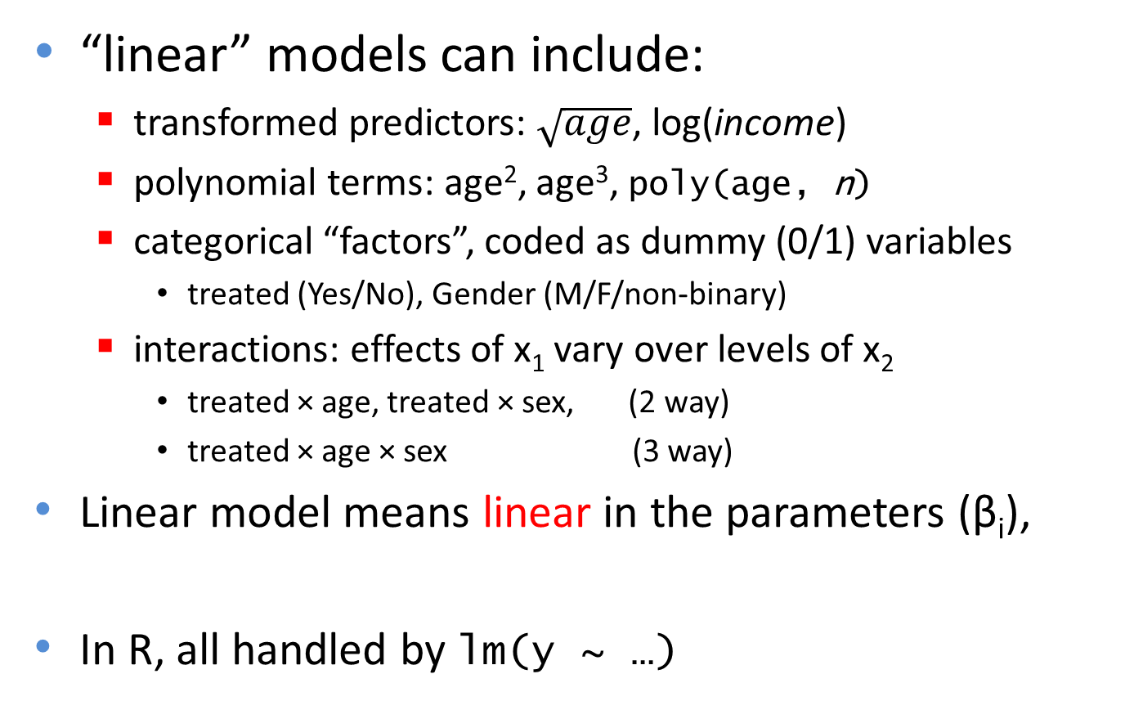
The General Linear Model
“linear” models can include:
transformed predictors: $\sqrt{age}$, log(income)
polynomial terms: age², age³, poly(age, n)
categorical “factors”, coded as dummy (0/1) variables
treated (Yes/No), Gender (M/F/non-binary)
interactions: effects of x₁ vary over levels of x₂
treated × age, treated × sex, (2 way)
treated × age × sex (3 way)
Linear model means linear in the parameters (β_{i}),
In R, all handled by lm(y ~ …)

Slide 18
Fitting linear models in R: lm()
In R, lm() for everything
Regression models (X1, ... quantitative)
ANOVA/ANCOVA models (A, B, ... factors)
lm(y ~ X1, data=dat) # simple linear regression
lm(y ~ X1+X2+X3, data=dat) # multiple linear regression
lm(y ~ (X1+X2+X3)^2, data=dat) # all two-way interactions
lm(log(y) ~ poly(X,3), data=dat) # arbitrary transformations
lm(y ~ A) # one way ANOVA
lm(y ~ A*B) # two way: A + B + A:B
lm(y ~ X + A) # one-way ANCOVA
lm(y ~ (A+B+C)^2) # 3-way ANOVA: A, B, C, A:B, A:C, B:C

Slide 19
Fitting linear models in R: lm()
Multivariate models: lm() with 2+ y vars
Multivariate regression
MANOVA/MANCOVA models
lm(cbind(y1, y2) ~ X1 + X2 + X3) # std MMreg: all linear
lm(cbind(y1, y2) ~ poly(X1,2) + poly(X2,2)) # response surface
lm(cbind(y1, y2, y3) ~ A * B) # 2-way MANOVA: A + B + A:B
lm(cbind(y1, y2, y3) ~ X + A) # MANCOVA (equal slopes)
lm(cbind(y1, y2) ~ X + A + X:A) # heterogeneous slopes

Slide 20
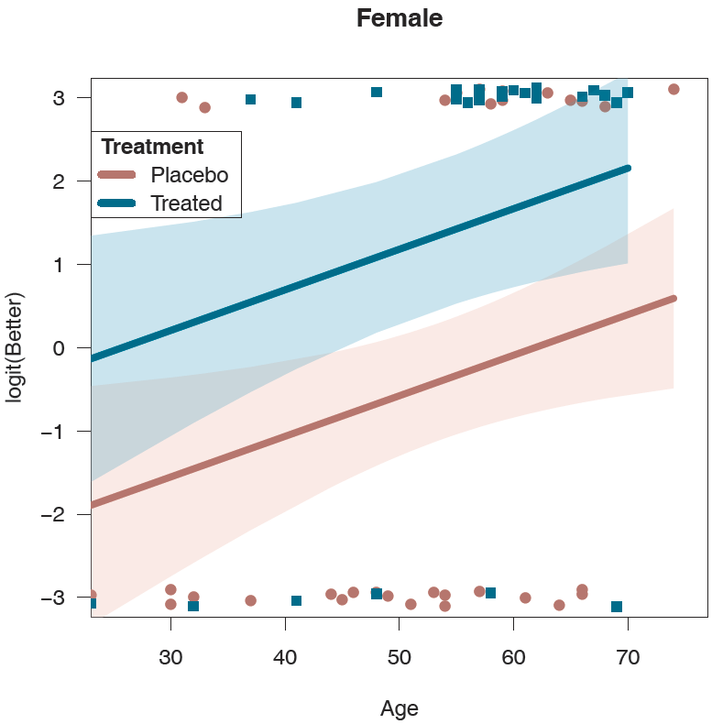
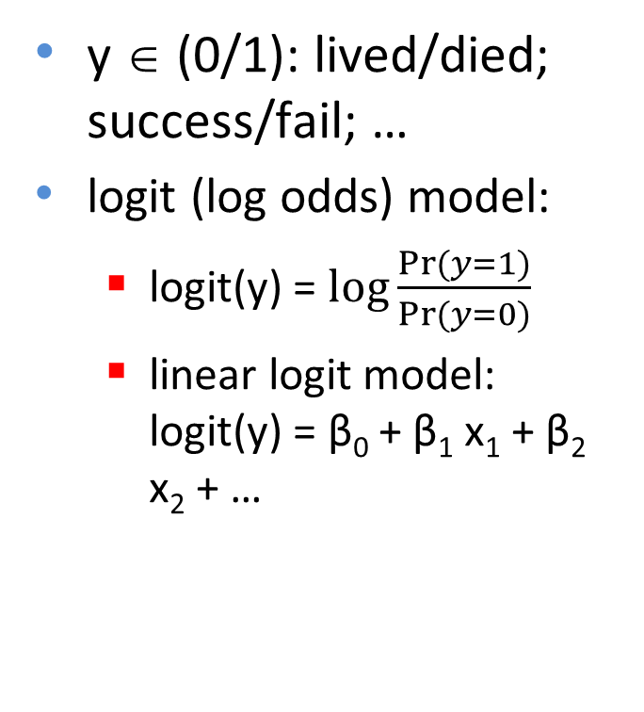
Generalized Linear Models: glm()
Transformations of y & other error distributions
y ∈ (0/1): lived/died; success/fail; …
logit (log odds) model:
logit(y) = $\log{\frac{Pr⁡(y=1)}{Pr⁡(y=0)}}$
linear logit model: logit(y) = β₀ + β₁ x₁ + β₂ x₂ + …
glm(better ~ age + treat, family=binomial,
data=Arthritis)

Slide 21
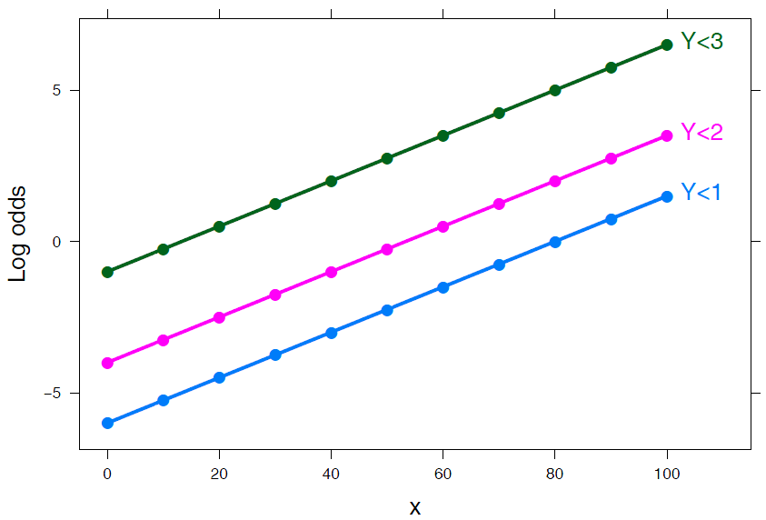
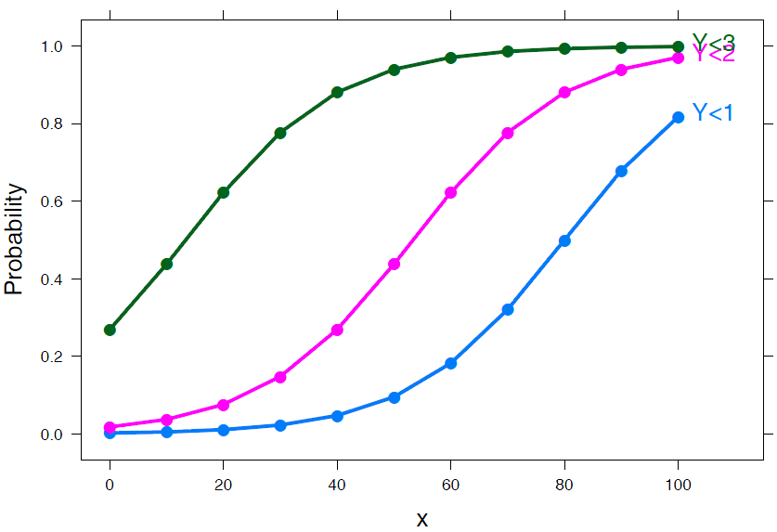
Generalized Linear Models
Ordinal responses
Improved ∈ (“None” < “Some” < “Marked”)
Models: Proportional odds, generalized logits, …
library(MASS)
polr(Improved ~ Sex + Treat + Age,
data=Arthritis)
library(nnet)
multinom(Improved ~ Sex + Treat + Age,
data=Arthritis)
The linear modeling framework remains the same!

Slide 22
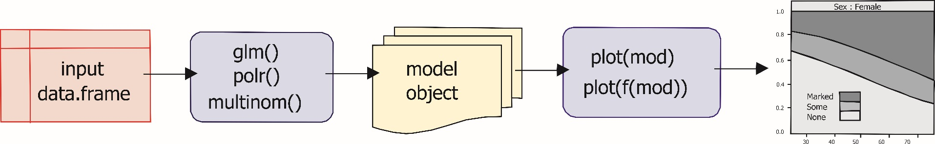
Model-based methods: Overview
models in R are specified by a symbolic model formula, applied to a data.frame
mod<-lm(prestige ~ income + educ, data=Prestige)
mod<-glm(better ~ age + sex + treat, data=Arthritis, family=binomial)
mod<-MASS:polr(improved ~ age + sex + treat, data=Arthritis)
result (mod) is a “model object”, of class “lm”, “glm”, …
method functions:
plot(mod), plot(f(mod)), …
summary(mod), coef(mod), predict(mod), …

Slide 23
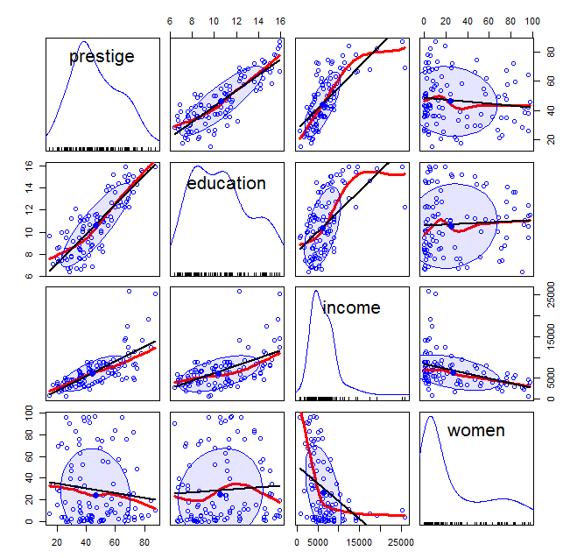
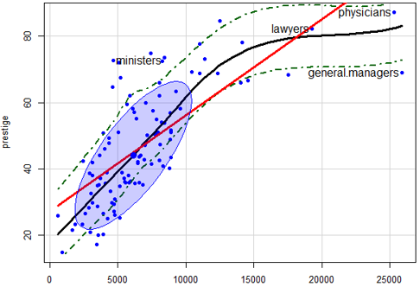
Plots for linear models
Data plots:
plot response (y) vs. predictors, with smooth summaries
scatterplot matrix --- all pairs

Slide 24
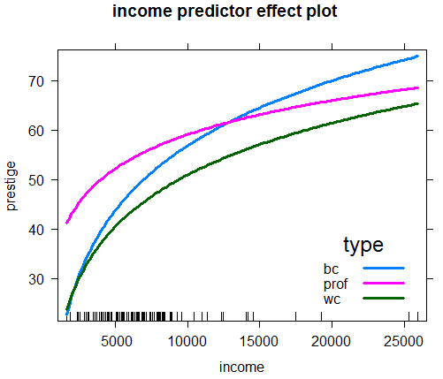
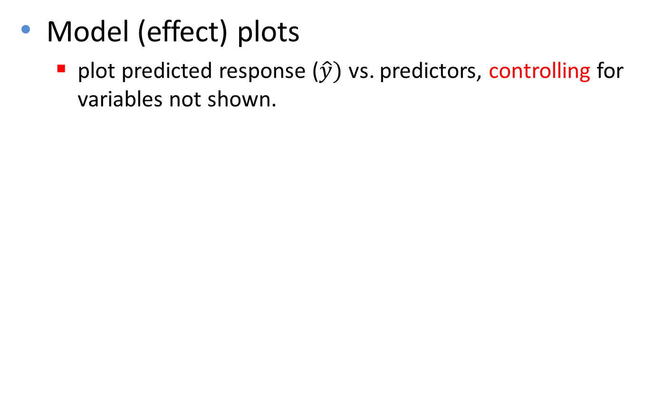
Plots for linear models
Model (effect) plots
plot predicted response ($\hat{y})$ vs. predictors, controlling for variables not shown.

Slide 25
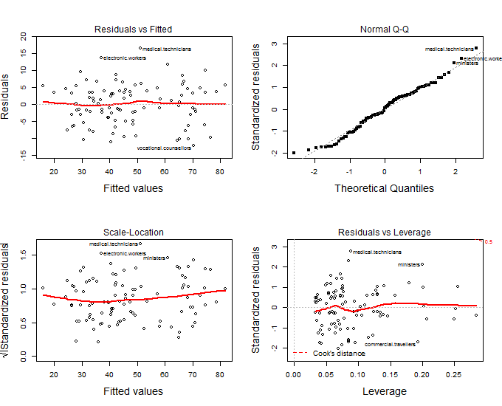
Plots for linear models
Diagnostic plots
N QQ plot: normality of residuals? outliers?
Influence plots: leverage & outliers
Spread-level plots (non-constant variance?)

Slide 26
R packages
car
Enhanced scatterplots
Diagnostic plots
effects
Plot fitted effects of one predictor, controlling all others
visreg
similar to effect plots, simpler syntax
Both effects & visreg handle nearly all formula-based models
lm(), glm(), gam(), rlm, nlme(), …

Slide 27
Occupational Prestige data
Data on prestige of 102 occupations and
average education (years)
average income ($)
% women
type (Blue Collar, Professional, White Collar)
> car::some(Prestige, 6)
education income women prestige census type
architects 15.44 14163 2.69 78.1 2141 prof
physicians 15.96 25308 10.56 87.2 3111 prof
commercial.artists 11.09 6197 21.03 57.2 3314 prof
tellers.cashiers 10.64 2448 91.76 42.3 4133 wc
bakers 7.54 4199 33.30 38.9 8213 bc
aircraft.workers 8.78 6573 5.78 43.7 8515 bc

Slide 28

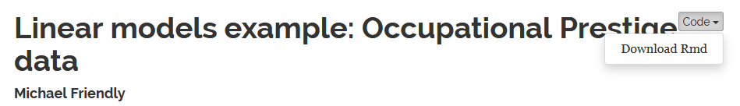
Follow along
The R script (prestige-ex.R) for this example is linked on the course page. Download and open in R Studio to follow along.
The script was run with `knitr` (ctrl+shift+K) in R Studio to create the HTML output (prestige-ex.html)
The Code button there allows you to download the R code and comments
(These show a simple way to turn R scripts into finished documents)

Slide 29
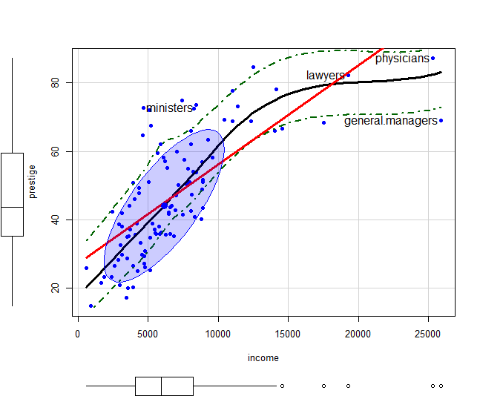
Informative scatterplots
Scatterplots are most useful when enhanced with annotations & statistical summaries
Data ellipse and regression line show the linear model, prestige ~ income
Point labels show possible outliers
Smoothed (loess) curve and CI show the trend
Boxplots show marginal distributions

Slide 30
Informative scatterplots
car::scatterplot() provides all these enhancements
scatterplot(prestige ~ income, data=Prestige,
pch = 16,
regLine = list(col = "red", lwd=3),
smooth = list(smoother=loessLine,
lty.smooth = 1, col.smooth = "black",
lwd.smooth=3, col.var = "darkgreen"),
ellipse = list(levels = 0.68),
id = list(n=4, col="black", cex=1.2))
Skewed distribution of income & non-linear relation suggest need for a transformation
Arrow rule: move on the scale of powers in direction of the bulge
e.g.: x → sqrt(income) or log(income)

Slide 31
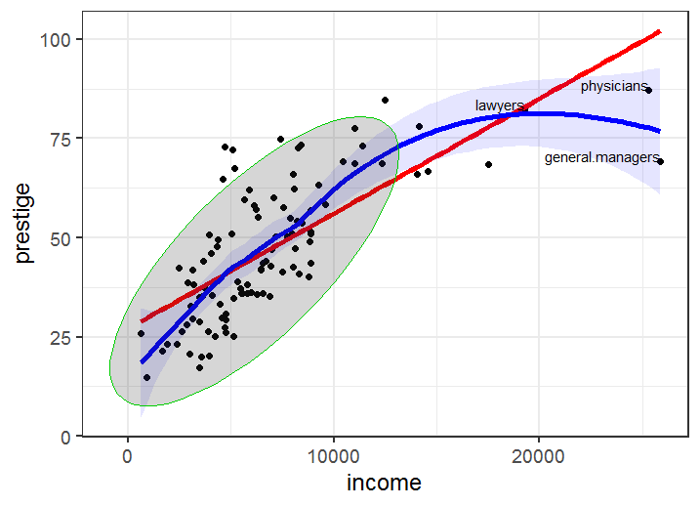
The same, with ggplot2
ggplot(data=Prestige,
aes(x = income, y = prestige)) +
geom_point(size=2) +
geom_smooth(method = "lm", color = "red", se=FALSE, size=2) +
geom_smooth(method = "loess", color = "blue", size = 2, fill="blue", alpha=0.1) +
stat_ellipse(geom = "polygon", alpha = 0.2, color = "green3") +
geom_text(aes(label=ifelse(income>18000, # select points to label (kludge!)
as.character(row.names(Prestige)),'')),
hjust=1, vjust=0) +
theme_bw(base_size = 18)
You can do the same with ggplot2, but it takes more steps to duplicate that plot
Each layer needs a geom_ or stat_

Slide 32
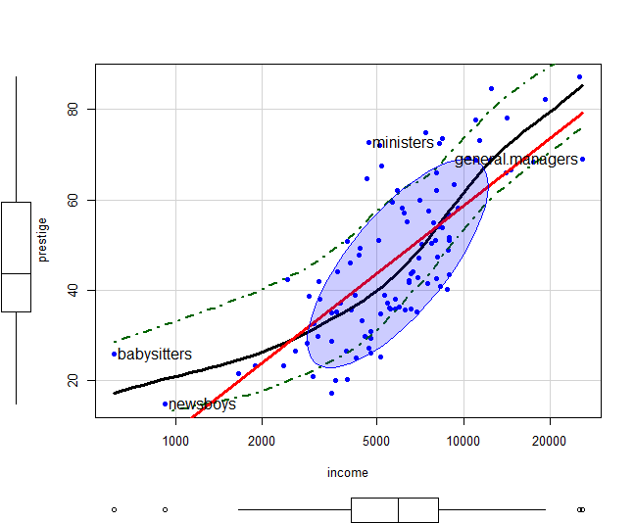
Try log(income)
scatterplot(prestige ~ income, data=Prestige,
log = "x", # plot on log scale
pch = 16,
regLine = list(col = "red", lwd=3),
… )
Income now ~ symmetric
Relation closer to linear
log(income): interpret as effect of a multiple
E.g., using log2(income)
> coef(mod_log)
(Intercept) log2(income)
-139.9 14.9
2 * income -> prestige ↑ 14.9

Slide 33
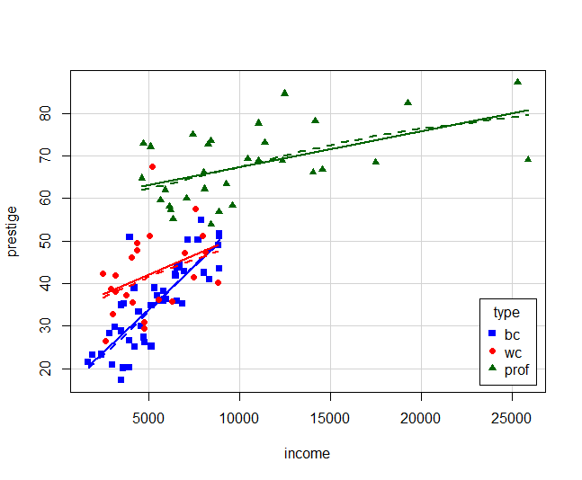
Stratify by type?
scatterplot(prestige ~ income | type, data=Prestige,
col = c("blue", "red", "darkgreen"),
pch = 15:17,
legend = list(coords="bottomright"),
smooth=list(smoother=loessLine, var=FALSE, span=1, lwd=4))
Formula: | type → “given type”
Different slopes: interaction of income * type
Provides another explanation of the non-linear relation
This may be a new finding!

Slide 34
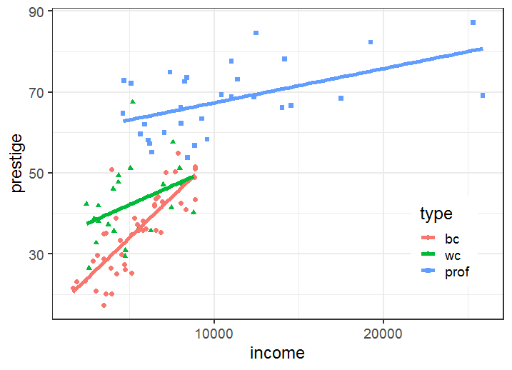
ggplot2 version
ggplot(data=subset(Prestige, !is.na(type)),
aes(x = income, y = prestige, color = type, shape=type)) +
geom_point(size=2) +
geom_smooth(method = "lm", se=FALSE, size=2) +
theme_bw(base_size = 18) +
theme(legend.position = c(0.87, 0.25))
Setting the color and shape aesthetics give different symbols and regression lines for each group

Slide 35
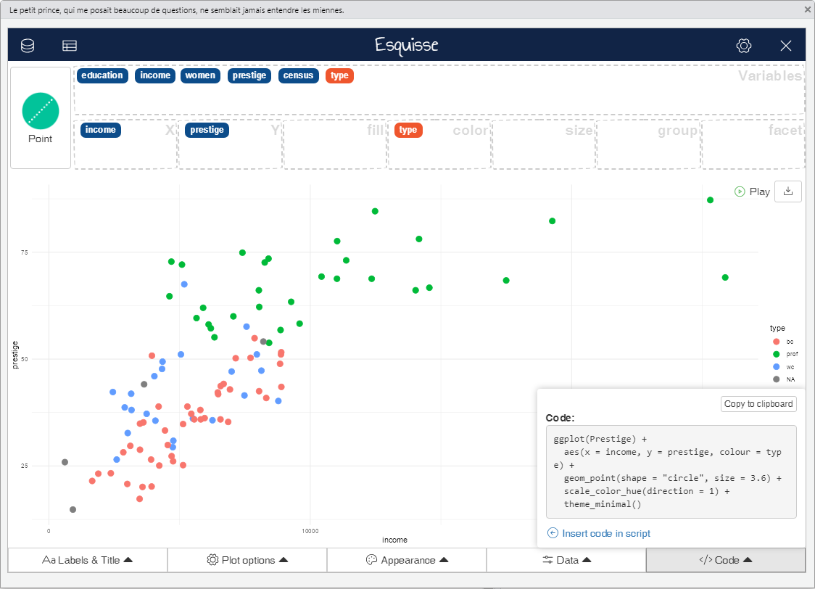
esquisse: Create plots interactively
esquisse: interactively create your plot, then save the ggplot code to a source file
drag variables to roles
copy code to clipboard or your source file

Slide 36
Scatterplot matrix
scatterplotMatrix(~ prestige + education + income + women ,
data=Prestige,
regLine = list(method=lm, lty=1, lwd=2, col="black"),
smooth=list(smoother=loessLine, spread=FALSE,
lty.smooth=1, lwd.smooth=3, col.smooth="red"),
ellipse=list(levels=0.68, fill.alpha=0.1))
prestige vs. all predictors
diagonal: univariate distributions
income: + skewed
%women: bimodal
off-diagonal: relations among predictors

Slide 37
Fit a simple model
> mod0 <- lm(prestige ~ education + income + women,
+ data=Prestige)
> summary(mod0)
Coefficients:
Estimate Std. Error t value Pr(>|t|)
(Intercept) -6.7943342 3.2390886 -2.098 0.0385 *
education 4.1866373 0.3887013 10.771 < 2e-16 ***
income 0.0013136 0.0002778 4.729 7.58e-06 ***
women -0.0089052 0.0304071 -0.293 0.7702
---
Signif. codes: 0 ‘***’ 0.001 ‘**’ 0.01 ‘*’ 0.05 ‘.’ 0.1 ‘ ’ 1
Multiple R-squared: 0.7982, Adjusted R-squared: 0.792
F-statistic: 129.2 on 3 and 98 DF, p-value: < 2.2e-16
Fits very well
But this ignores:
nonlinear relation with income: should use log(income)
occupation type
possible interaction of income*type

Slide 38
Fit a more complex model
> mod1 <- lm(prestige ~ education + women +
+ log(income)*type, data=Prestige)
> summary(mod1)
Coefficients:
Estimate Std. Error t value Pr(>|t|)
(Intercept) -152.20589 23.24988 -6.547 3.54e-09 ***
education 2.92817 0.58828 4.978 3.08e-06 ***
women 0.08829 0.03234 2.730 0.00761 **
log(income) 18.98191 2.82853 6.711 1.67e-09 ***
typeprof 85.26415 30.45819 2.799 0.00626 **
typewc 29.41334 36.50749 0.806 0.42255
log(income):typeprof -9.01239 3.41020 -2.643 0.00970 **
log(income):typewc -3.83343 4.26034 -0.900 0.37063
---
Signif. codes: 0 ‘***’ 0.001 ‘**’ 0.01 ‘*’ 0.05 ‘.’ 0.1 ‘ ’ 1
Multiple R-squared: 0.8751, Adjusted R-squared: 0.8654
F-statistic: 90.07 on 7 and 90 DF, p-value: < 2.2e-16
add interaction of log income by type
Fits even better!
But how to understand?
Coefs for type compare mean “wc” and “prof” to “bc”
Coefs for log(income)*type compare “wc” and “prof” slopes with that of “bc”

Slide 39

Coefficient plots
Plots of coefficients with CI often more informative than tables, but care is needed
Compare 3 models:
mod0 <- lm(prestige ~ education + income + women, data=Prestige)
mod1 <- lm(prestige ~ education + women + income + type, data=Prestige)
mod2 <- lm(prestige ~ education + women + income * type, data=Prestige)
The modelsummary package gives reasonably nice plots. Feed it a list of models:
library(modelsummary)
models <- list("mod0" = mod0, "mod1" = mod1, "mod2" = mod2)
modelplot(models,
coef_omit="Intercept",
size=1.3, alpha=0.7) +
labs(title="Raw coefficients")

Slide 40
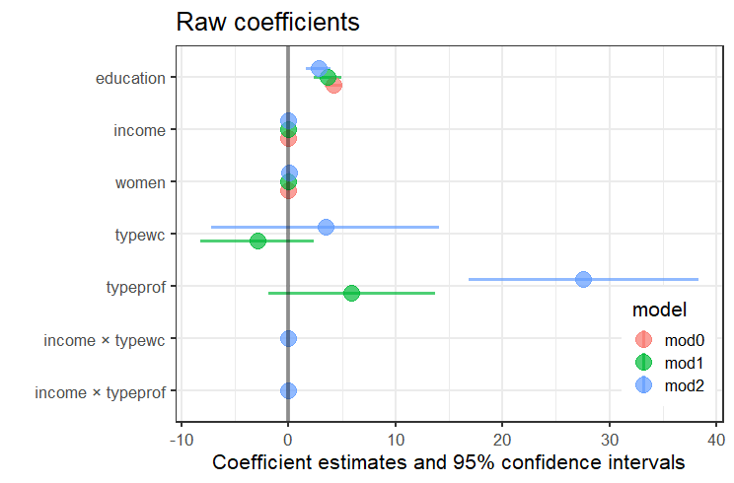
Coefficient plots
Raw b coefficients are on different scales, so are not comparable
✗
Effect of income appears to be NS

Slide 41
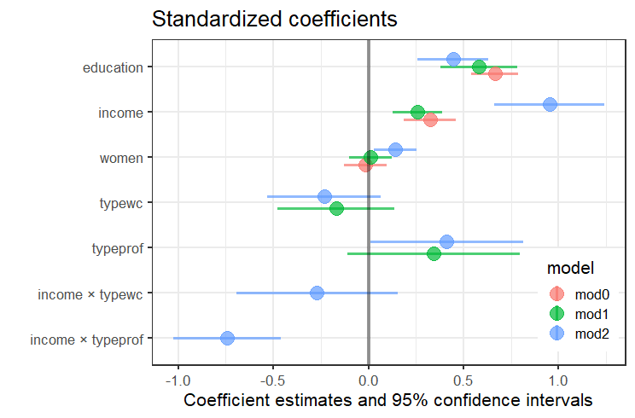
Instead, plot the standardized β coefficients.
Get these by scaling the variables to mean=0, stddev=1
Re-fit the models to the standardized data
Prestige_std <- Prestige |> mutate(across(where(is.numeric), scale))
mod0_std <- lm(prestige ~ education + income + women, data=Prestige_std)
mod1_std <- lm(prestige ~ education + women + income + type, data=Prestige_std)
mod2_std <- lm(prestige ~ education + women + income * type, data=Prestige_std)
✓
This reflects the results shown in tabular output
Effect of income is signif. in all 3 models

Slide 42
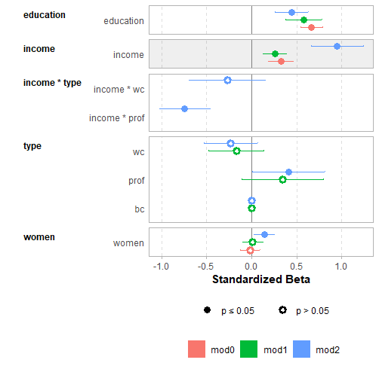
GGally::ggcoef_*() plots
The GGally package provides ggcoef_plot() and ggcoef_compare() for pretty plots
It uses the broom package to extract information from models
models <- list("mod0" = mod0_std,
"mod1" = mod1_std,
"mod2" = mod2_std)
ggcoef_compare(models) +
xlab("Standardized Beta")
The reference category is shown for factors, facilitating interpretation

Slide 43
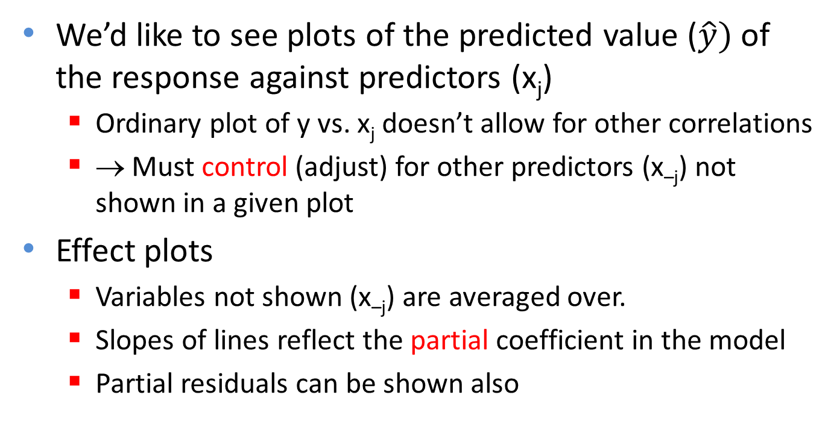
Model (effect) plots
We’d like to see plots of the predicted value ($\hat{y})$ of the response against predictors (x_{j})
Ordinary plot of y vs. x_{j} doesn’t allow for other correlations
→ Must control (adjust) for other predictors (x_{–j}) not shown in a given plot
Effect plots
Variables not shown (x_{–j}) are averaged over.
Slopes of lines reflect the partial coefficient in the model
Partial residuals can be shown also
For details, see vignette(“predictor-effects-gallery”, package=“effects)

Slide 44
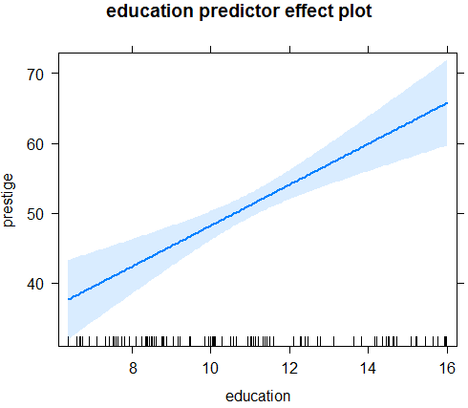
Model (effect) plots: education
library("effects")
mod1.e1 <- predictorEffect("education", mod1)
plot(mod1.e1)
This graph shows the partial slope for education, controlling for all others
For each ↑ year in education, fitted prestige ↑2.93 points, (other predictors held fixed)

Slide 45
Model (effect) plots
mod1.e1a <- predictorEffect("education", mod1, residuals=TRUE)
plot(mod1.e1a,
residuals.pch=16, id=list(n=4, col="black"))
Partial residuals show the residual of prestige controlling for other predictors
Unusual points here would signal undue influence

Slide 46
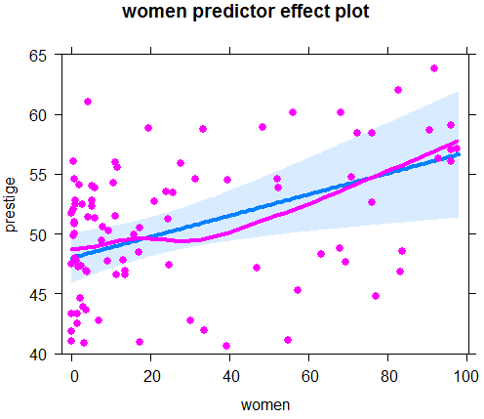
Model (effect) plots: women
mod1.e2 <- predictorEffect("women", mod1, residuals=TRUE)
plot(mod1.e2, ylim=c(40, 65), lwd=4,
residuals.pch=16)
Surprise!
Prestige of occupations ↑ with % women (controlling for other variables)
Another 10% women ↑ prestige by 0.88 points
How to interpret this?

Slide 47
Model (effect) plots: income
plot(predictorEffect("income", mod1),
lines=list(multiline=TRUE, lwd=3),
key.args = list(x=.7, y=.35))
Income interacts with type in the model
The plot is curved because log(income) is in the model
Curvature reflects marginal effect of income for each occupation type

Slide 48
visreg plots: Air quality data
Daily air quality measurements in New York, May - Sep 1973
How does Ozone concentration vary with solar radiation, wind speed & temperature?
> head(airquality)
Ozone Solar.R Wind Temp Month Day
1 41 190 7.4 67 5 1
2 36 118 8.0 72 5 2
3 12 149 12.6 74 5 3
4 18 313 11.5 62 5 4
5 NA NA 14.3 56 5 5
6 28 NA 14.9 66 5 6
see: https://pbreheny.github.io/visreg/ for examples & details

Slide 49
Air quality: main effects model
> fit1 <- lm(Ozone ~ Solar.R + Wind + Temp, data=airquality)
> summary(fit1)
Coefficients:
Estimate Std. Error t value Pr(>|t|)
(Intercept) -64.3421 23.0547 -2.79 0.0062 **
Solar.R 0.0598 0.0232 2.58 0.0112 *
Wind -3.3336 0.6544 -5.09 1.5e-06 ***
Temp 1.6521 0.2535 6.52 2.4e-09 ***
---
Signif. codes: 0 ‘***’ 0.001 ‘**’ 0.01 ‘*’ 0.05 ‘.’ 0.1 ‘ ’ 1
Residual standard error: 21.18 on 107 degrees of freedom
(42 observations deleted due to missingness)
Multiple R-squared: 0.6059, Adjusted R-squared: 0.5948
F-statistic: 54.83 on 3 and 107 DF, p-value: < 2.2e-16

Slide 50
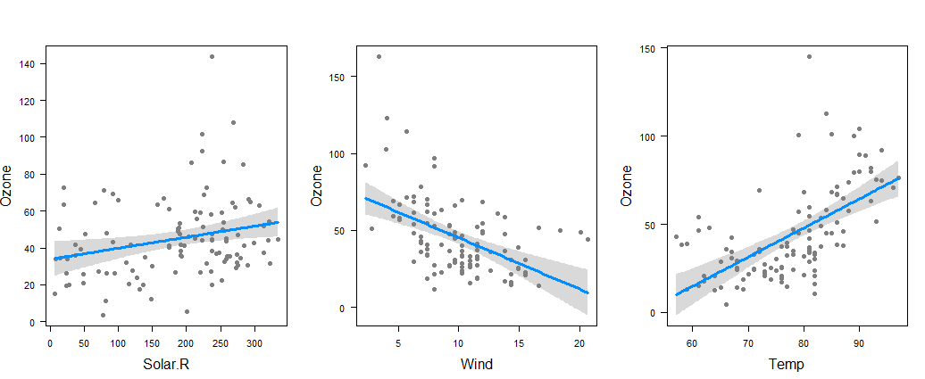
visreg conditional plots
visreg(fit1, "Solar.R“)
visreg(fit1, "Wind“)
visreg(fit1, "Temp")
model summary =
predicted values (line) +
confidence band (uncertainty) +
partial residuals (objections)

Slide 51
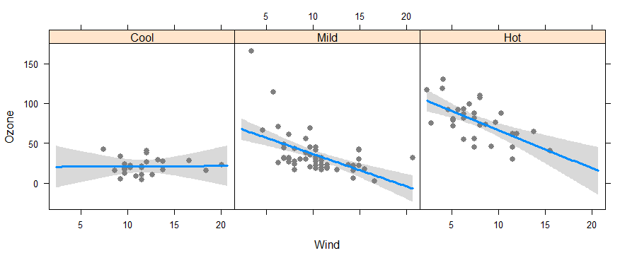
Factor variables & interactions
# cut Temp into three ordered levels of equal range
airquality$Heat <- cut(airquality$Temp, 3,
labels=c("Cool","Mild","Hot"))
# fit model with interaction of Wind * Heat
fit2 <- lm(Ozone ~ Solar.R + Wind*Heat, data=airquality)
visreg(fit2, "Wind", by="Heat", layout=c(3,1), points=list(cex=1))

Slide 52
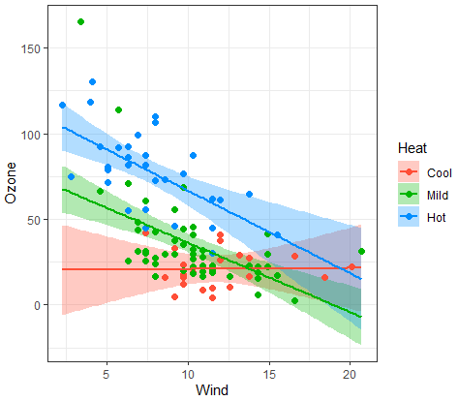
Factor variables & interactions
visreg(fit2, "Wind", by="Heat",
overlay=TRUE,
gg=TRUE,
points=list(size=2)) +
theme_bw()
overlay=TRUE → superpose panels
gg=TRUE → uses ggplot
This allows slope for Wind to vary with Heat e.g., Wind has no effect when Cool
This model still assumes linear effects of Heat & Wind

Slide 53
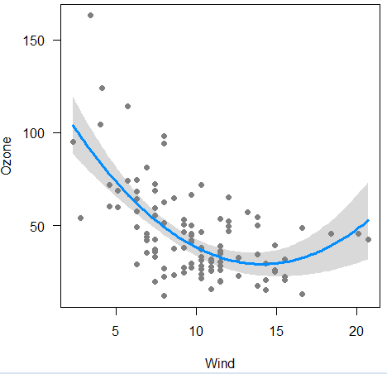
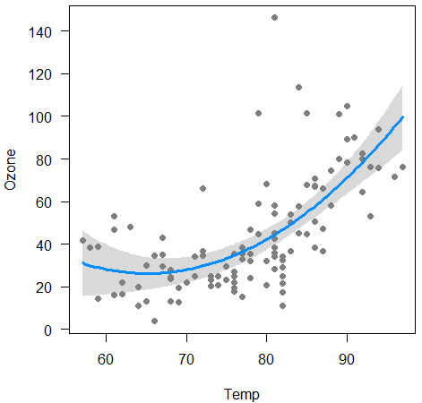
Non-linear effects
fit <- lm(Ozone ~ Solar.R + poly(Wind,2) +
Temp, data=airquality)
visreg(fit, "Wind“)
fit <- lm(Ozone ~ Solar.R + Wind +
poly(Temp,2), data=airquality)
visreg(fit, "Temp")

Slide 54
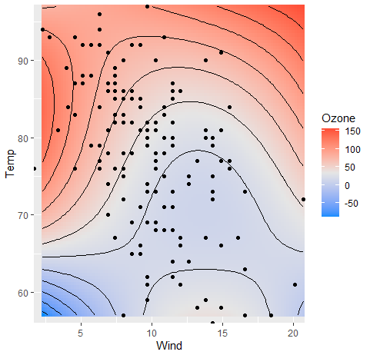
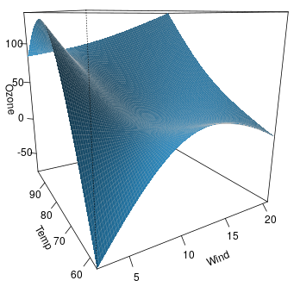
Response surface models (visreg2d)
# Fit quadratics in both Wind & Temp and interaction Wind * Temp
fitp <- lm(Ozone ~ Solar.R + poly(Wind,2) * poly(Temp,2), data=airquality)
visreg2d(fitp, "Wind", "Temp", plot.type="gg") +
geom_contour(aes(z=z), color="black")
visreg2d(fitp, "Wind", "Temp", plot.type="persp“ )

Slide 55
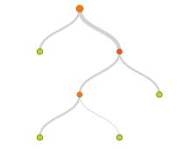
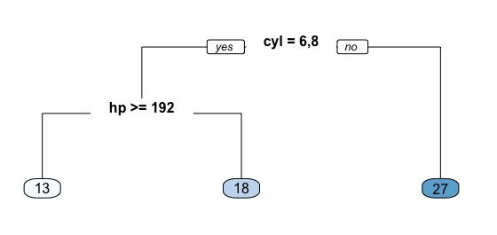
Regression trees
Regression trees are a non-parametric alternative to linear models
x₁
Essential ideas:
Find predictor and split value which minimizes SSE
fitted value in each subgroup = mean
repeat, recursively, splitting by next best predictor
Large literature
cost, complexity tradeoff
pruning methods
boosting, cross-validation
tree averaging
< c₁
x₂
< c₂
x₃
< c₃
e.g.: mpg ~ cyl + hp

Slide 56
Prestige data: rpart tree
> library(rpart) # calculating regression trees
> library(rpart.plot) # plotting regression trees
> rmod <- rpart(prestige ~ education + income + women + type,
data=Prestige,
method = "anova")
> rpart.rules(rmod) # print prediction rules
prestige
24 when education < 10 & income < 3600
33 when education < 10 & income is 3600 to 6078
41 when education is 10 to 12 & income < 6078
46 when education < 12 & income >= 6078
63 when education is 12 to 14
73 when education >= 14
Only education & income are involved in this simple model.
Other controls allow setting classification details

Slide 57

Prestige data: rpart tree
rpart.plot(rmod, prefix="prestige=")
higher on predictors
lower on predictors

Slide 58
Diagnostic plots
The linear model, assumes:
Residuals, ε_{i} are normally distributed, ε_{i} ~ N(0,σ²)
(Normality not required for Xs)
Constant variance, Var(ε_{i}) = σ²
Observations y_{i} are statistically independent
Violations → inferences may not be valid
A variety of plots can diagnose all these problems
Other methods (boxCox, boxTidwell) diagnose the need for transformations of y or Xs.

Slide 59
The “regression quartet”
In R, plotting a lm model object → the “regression quartet” of plots
plot(mod1, lwd=2, cex.lab=1.4)
❶
❷
❶ Residuals: should be flat vs. fitted values ✓
❷ Q-Q plot: should follow the 45º line ✓
❸
❹
❸ Scale-location: should be flat if constant variance ✓
❹ Resids vs. leverage: can show influential observations

Slide 60


Unusual data: Leverage & Influence
“Unusual” observations can have dramatic effects on least-squares estimates in linear models
Three archetypal cases:
Typical X (low leverage), bad fit -- Not much harm
Unusual X (high leverage), good fit -- Not much harm
Unusual X (high leverage), bad fit -- BAD, BAD, BAD
Influential observations: unusual in both X & Y
Heuristic formula:
Influence = X leverage x Y residual

Slide 61
Influence plots
Influence (Cook’s D) measures impact of individual obs. on coefficients, fitted values
Influence ∼ Residual (y -ŷ) × Hat-value
High leverage
Bubble size ~ influence
High influence
Bad fit
influencePlot(mod1)
Bad fit

Slide 62

Spread-level plots
To diagnose non-constant variance, plot:
log |Std. residual| vs. log (x)
log (IQR) vs log (median) [for grouped data]
If ≈ linear w/ slope b, transform y → y ^{(1-b)}
Artificial data, generated so σ ~ x
b ≈ 1 → power = 0
→ analyze log(y)

Slide 63

Spread-level plot: baseball data
Data on salary and batter performance from 1987 season
data("Baseball", package="vcd")
bb.mod <- lm(sal87 ~ years + hits + runs + homeruns, data=Baseball)
spreadLevelPlot(bb.mod, pch=16, lwd=3,
id=list(n=2))
## Suggested power transformation: 0.2609
slope = .74 → p = .26
i.e., y → log(y) or y^{1/4}
NB: both axes plotted on log scale

Slide 64


Box Cox transformation
Box & Cox proposed to transform y to a power, y → y^{(λ)} to minimize the residual SS (or maximize the likelihood)
Makes y^{(λ)} more nearly normal
Makes y^{(λ)} more nearly linear in with X
Formula for y^{(λ)}
y⁽⁰⁾ : log_{e}(y)
λ < 0: flip sign to keep same order

Slide 65


Example: Cars93 data
How does gas mileage (MPG.city) depend on vehicle weight?
> cars.mod <- lm(MPG.city ~ Weight, Cars93)
> coef(cars.mod)
(Intercept) Weight
47.04835 -0.00803
Relationship clearly non-linear
Tukey arrow rule: transform Y (or X)
as arrow thru the curve bulges
y → $\sqrt{y}$, log(y), 1/y
x → $\sqrt{x}$, log(x), 1/x

Slide 66


MASSextra package: box_cox()
> library(MASSExtra)
> box_cox(cars.mod) # plot log likelihood vs. lambda
> lamba(cars.mod)
[1] -1.26
The plot of – log(L) ~ RSS shows the minimum & CI
plot (bc(MPG.city, lamba(cars.mod))
y⁻¹

Slide 67


easystats: performance package
library(performance)
check_model(mod0)
This package gives all the standard plots plus some others
Captions indicate what should be seen for a good model

Slide 68

easystats: report package
The report package generates a textual description of the results of a fitted model
library(report); report(mod0)
We fitted a linear model (estimated using OLS) to predict prestige with education (formula: prestige ~ education + income + women + type). The model explains a statistically significant and substantial proportion of variance (R2 = 0.83, F(5, 92) = 93.07, p < .001, adj. R2 = 0.83). The model's intercept, corresponding to education = 0, is at 0.18 (95% CI [-13.81, 14.18], t(92) = 0.03, p = 0.979). Within this model:
The effect of education is statistically significant and positive (beta = 3.66, 95% CI [2.38, 4.95], t(92) = 5.67, p < .001; Std. beta = 0.59, 95% CI [0.38, 0.80])
The effect of income is statistically significant and positive (beta = 1.04e-03, 95% CI [5.22e-04, 1.56e-03], t(92) = 3.98, p < .001; Std. beta = 0.26, 95% CI [0.13, 0.39])
The effect of women is statistically non-significant and positive (beta = 6.44e-03, 95% CI [-0.05, 0.07], t(92) = 0.21, p = 0.832; Std. beta = 0.01, 95% CI [-0.10, 0.12])
The effect of type [linear] is statistically non-significant and positive (beta = 4.18, 95% CI [-1.35, 9.71], t(92) = 1.50, p = 0.137; Std. beta = 0.24, 95% CI [-0.08, 0.57])
The effect of type [quadratic] is statistically significant and positive (beta = 4.79, 95% CI [1.72, 7.86], t(92) = 3.10, p = 0.003; Std. beta = 0.28, 95% CI [0.10, 0.46])

Slide 69
Summary
Tables are for look-up; graphs can give insight
“Linear” models include so much more than ANOVA & regression
Data plots are more effective when enhanced
data ellipses → strength & precision of correlation
regression lines and smoothed curves
point identification → noteworthy observations
Effect plots show informative views of models
Visualize conditional effects, holding others constant
Diagnostic plots can reveal:
violations of assumptions,
influential observations,
need for transformations.

